Slide 1


CSE 455 Software Testing
Lecture 10
This course is offered to the students of students of BS Software Engineering who are enrolled in 8th semester

Slide 2
Course instructor Yella mehroze
yellamehroze@cuilahore.edu.pk

Slide 3

Software test plan
Notes:
NOTE:
To change the image on this slide, select the picture and delete it. Then click the Pictures icon in the placeholder to insert your own image.

Slide 4
Software Test Plan
Test Plan Template
IEEE 829 Format

Slide 5
Outline
Introduction
The goal of test planning
Test planning topics
Test Plan Identifier
References
Introduction
Test Items (Functions)
Software Risk Issues
Features to be tested
Features not to be tested
Approach (Strategy)
Item Pass/Fail Criteria
Suspension Criteria and Resumption Requirements
Test Deliverables
Remaining Test Tasks
Environmental Needs
Staffing and Training Needs
Responsibilities
Schedule
Planning Risks and Contingencies
Approvals
Glossary

Slide 6
Introduction
The most fundamental test document
Test lead will be responsible to create comprehensive test plan
Tester will assist in its creation
Tester can use this information to organize his own testing tasks

Slide 7
The goal of test planning
The test plan is a by-product of the detailed planning process that is undertaken to create it.
It’s the planning process that matters, not the resulting document
The ultimate goal of the test planning process is communicating (not recording)
Test team’s intent
Test team’s expectations
Test team’s understanding of the testing that’s to be performed

Slide 8
Test planning topics vs. Test planning templates
Many software test plan templates are available
By using these templates a document can be easily prepared
Emphasis should be on the planning process and not the document
So the focus should be the topics that need to be covered in test plan
Planning is a dynamic process, so where you feel these topics do not cover your project feel free to adjust it accordingly

Slide 9
Test planning topics

Slide 10
1- Test Plan Identifier
Unique number to identify the test plan
The number may also identify whether the test plan is
Master plan
Level plan (Unit, Integration, System and acceptance test plan)
Testing Type Specific Test Plans (Performance, Security Test Plan etc)
Keep in mind
Test plans are like other software documentation
They are dynamic in nature and must be kept up to date
They have revision numbers
You may include
Author
Contact information
Revision history information

Slide 11
Document History and Distribution
Revision History
Author | Description of Change | Revision Date | Revision #
2. Distribution
Distribution Method | Recipient Organization | Recipient Name

Slide 12
2- References
List all documents that support this test plan
Refer to the actual version/release number of the document
As stored in the configuration management system
Do not duplicate the text from other documents
It will reduce the viability (practicality) of this document and increase the maintenance effort
Documents that can be referenced include:
Project Plan
Requirements specifications (Software / Business)
High Level design document
Detail design document
Development and Test process standards
Methodology guidelines and examples
Corporate standards and guidelines

Slide 13
3- Introduction
State the purpose of the Plan
Possibly identifying the level of the plan (master etc.)
Executive summary part of the plan
Identify the Scope of the plan in relation to the Software Project plan
Other items may include
Resource and budget constraints
Process to be used for change control
Communication and coordination of key activities
As this is the “Executive Summary” keep information brief and to the point.

Slide 14
4- Test Items (Functions)
Things you intend to test within the scope of the test plan
List of what is to be tested
This can be developed from the software application inventories as well as other sources of documentation and information.
This can be controlled and defined by local Configuration Management (CM) process.
Remember, what you are testing is what you intend to deliver to the Client.
This section can be oriented to the level of the test plan
For higher levels it may be by application or functional area
For lower levels it may be by program, unit, module or build

Slide 15
5- Software Risk Issues
Identify what software is to be tested and what the critical areas are, such as:
Delivery of a third party product.
New version of interfacing software
Ability to use and understand a new package/tool, etc.
Extremely complex functions
Modifications to components with a past history of failure
Poorly documented modules or change requests
There are some inherent software risks such as complexity; these need to be identified
Safety
Multiple interfaces
Impacts of operations on Client
Government regulations and rules

Slide 16
5- Software Risk Issues
Misunderstanding of the original requirements
This can occur at the management, user and developer levels
The past history of defects will help identify potential areas within the software that are risky.
It is the nature of defects to cluster and clump together.
Good approach to identify risks
To have several brainstorming sessions
Identify them early so that they do not appear as surprise late in the project
Examples: Risks can be
A new tester assigned to test the software of a new nuclear power plant
Time to test a project is too short to meet the schedule

Slide 17
6- Features to be tested
Listing of what is to be tested from the USERS viewpoint of what the system does.
This is not a technical description of the software
Set the level of risk for each feature
Use a simple rating scale such as (H, M, L): High, Medium and Low.
These types of levels are understandable to a User.
Be prepared to discuss why a particular level was chosen

Slide 18
Test Items v/s Features to be tested (Section 4 v/s Section 6)
Section 4 and Section 6 are very similar?
The only true difference is the point of view.
Section 4 is a technical type description including version numbers and other technical information
Section 6 is from the User’s viewpoint
Users do not understand technical software terminology; they understand functions and processes as they relate to their jobs.

Slide 19
7- Features not to be tested
Listing of what is NOT to be tested from both
The Users viewpoint of what the system does
Configuration management/version control view
Identify WHY the feature is not to be tested, there can be any number of reasons.
Not to be included in this release of the Software
Low risk, has been used before and is considered stable
Will be released but not tested or documented as a functional part of the release of this version of the software
Some components previously released are already tested
An outsourcing company may supply pre-tested portion of the product

Slide 20
7- Features not to be tested
Sections 6 and 7 are directly related to Sections 5
What will and will not be tested are directly affected by the levels of acceptable risk within the project
What does not get tested affects the level of risk of the project
However a code slipped through the development cycle untested because of misunderstanding would be a disaster

Slide 21
8- Approach (Strategy)
It should be appropriate to the level of the plan (master, acceptance, etc.)
It should be in agreement with all higher and lower levels of plans.
Overall rules and processes should be identified.
Either you have to use black box testing or white box testing or a mixed approach?
When to apply each approach and to what part of the software?
Which part of code tested manually and which through automation?
Are any special tools to be used?
Whether the tools will be developed or existing tools will be purchased
Will the tool require special training?
What metrics will be collected?
How is Configuration Management to be handled?
How many different configurations will be tested?

Slide 22
8- Approach (Strategy)
Combinations of HW, SW and other vendor packages
What levels of regression testing will be done and how much at each test level?
Will regression testing be based on severity of defects detected?
How will elements in the requirements and design that do not make sense or are un-testable to be processed?
Would it be better to outsource entire test effort
If this is a master test plan
Overall project testing approach and coverage requirements must also be identified
Specify if there are special requirements for the testing
Only the full component will be tested
A specified segment of grouping of features/components must be tested together.

Slide 23
8- Approach (Strategy)
Other information that may be useful in setting the approach are:
MTBF, Mean Time Between Failures - if this is a valid measurement for the test involved and if the data is available.
How will meetings and other organizational processes be handled?
Test strategy needs to be made by experienced testers
Everyone in the project team should understand and be in agreement with test strategy

Slide 24
9- Item Pass/Fail Criteria
What are the Completion criteria for this plan?
This is a critical aspect of any test plan and should be appropriate to the level of the plan.
At the Unit test level this could be items such as:
All test cases completed.
A specified percentage of cases completed with a percentage containing some number of minor defects.
Code coverage tool indicates all code covered.
At the Master test plan level this could be items such as:
All lower level plans completed.
A specified number of plans completed without errors and a percentage with minor defects.

Slide 25
9- Item Pass/Fail Criteria
This could be
An individual test case level criterion
A unit level plan
General functional requirements for higher level plans
What is the number and severity of defects located need to be considered?

Slide 26
10- Suspension Criteria and Resumption Requirements
Know when to pause in a series of tests.
If the number or type of defects reaches a point where the follow on testing has no value, it makes no sense to continue the test
Specify
What constitutes stoppage for a test or series of tests
What is the acceptable level of defects that will allow the testing to proceed

Slide 27
11- Test Deliverables
What is to be delivered as part of this plan?
Test plan document
Test cases
Test design specifications
Tools and their outputs
Simulators
Static and dynamic generators
Error logs and execution logs
Problem reports and corrective actions
One thing that is not a test deliverable is
Software itself that is listed under test items and is delivered by development

Slide 28
12- Remaining Test Tasks
If this is a multi-phase process or if the application is to be released in increments
There may be parts of the application that this plan does not address.
These areas need to be identified to avoid any confusion. Defects should not be reported back on those future functions.
This will also allow the users and testers to avoid incomplete functions and prevent waste of resources chasing non-defects.
If the project is being developed as a multi-party process
This plan may only cover a portion of the total functions/features.
This status needs to be identified so that those other areas have plans developed for them
So to avoid wasting resources tracking defects that do not relate to this plan.
When a third party is developing the software, this section may contain descriptions of those test tasks belonging to both the internal groups and the external groups.

Slide 29
13- Environmental Needs
Are there any special requirements for this test plan, such as:
Special simulators, static generators etc. required
How will test data be provided.
Are there special collection requirements or specific ranges of data that must be provided?
How much testing will be done on each component of a multi-part feature?
Specific versions of other supporting software?

Slide 30
14- Staffing and Training Needs
Training on the application/system
Training for any test tools to be used
What is to be tested and who is responsible for the testing and training?
What should be the skill level of the assigned staff?

Slide 31
15- Responsibilities
Who is in charge?
What assigned staff will do?
This issue includes all areas of the plan e.g.
Setting risks
Selecting features to be tested and not tested
Setting overall strategy for this level of plan
Ensuring all required elements are in place for testing
Providing for resolution of scheduling conflicts
Who provides the required training?
Who makes the critical go/no go decisions for items not covered in the test plans?

Slide 32
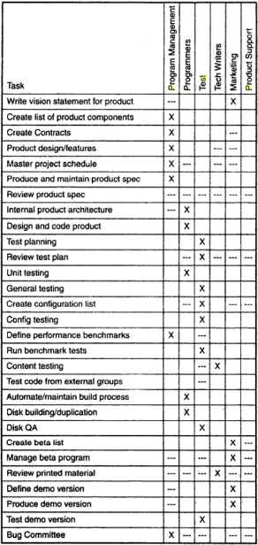
15- Responsibilities
The test team’s work is driven by many other functional groups- programmers, project managers, technical writers and so on
If responsibilities are not planned, testing becomes a comedy show
Deciding which tasks to list comes with experience. Each project is different, so you can question about the projects that which tasks are neglected

Slide 33
16- Schedule
Should be based on realistic and validated estimates
If the estimates for the development of the application are inaccurate, the entire project plan will slip
And testing is part of the overall project plan
All relevant milestones should be identified with their relationship to the development process.
This will also help in identifying and tracking potential slippage in the schedule caused by the test process.
It is critical because the features, considered easy to design and code may be very time consuming to test
Some features may be postponed to a later release based on the test schedule

Slide 34
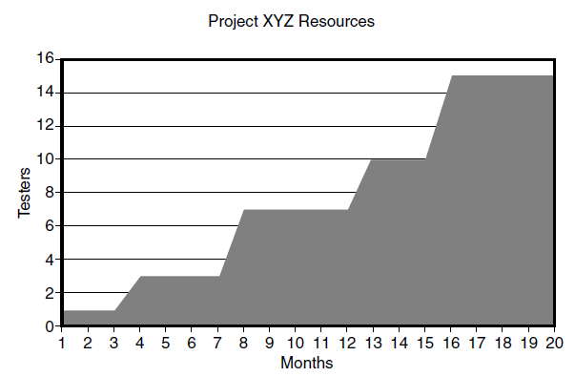
16- Schedule
Test work typically is not distributed evenly over the entire product development cycle
Some testing occurs early in the form of reviews
Number of testing tasks, number of people and amount of time spent often increases over course of project

Slide 35
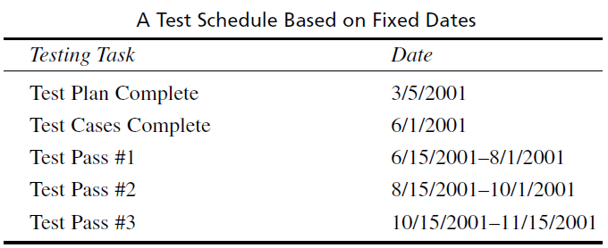
16- Schedule
When time allotted for application testing is limited, how can a test manager and team possibly organize, implement and manage ample test coverage, this is called schedule crunch
The solution is to avoid absolute dates for starting and stopping tasks in test schedule

Slide 36
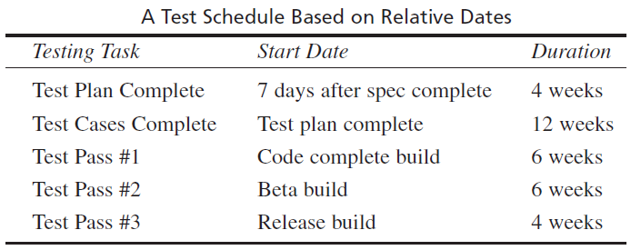
16- Schedule
If test schedule uses relative dates based on entrance and exit criteria defined by testing phases, it becomes clear that the testing tasks rely on some other deliverables being completed first

Slide 37
17- Planning Risks and Contingencies
What are the overall risks to the project with an emphasis on the testing process?
Lack of personnel resources when testing is to begin.
Lack of availability of required hardware, software, data or tools.
Late delivery of the software, hardware or tools.
Delays in training on the application and/or tools.
Changes to the original requirements or designs.

Slide 38
17- Planning Risks and Contingencies
Specify what will be done for various events, for example:
If the requirements change after baselining, following actions will be taken
The test schedule and development schedule will move out an appropriate number of days. This rarely occurs, as most projects tend to have fixed delivery dates.
The number of test performed will be reduced.
The number of acceptable defects will be increased.
The above two items could lower the overall quality of the delivered product
Resources will be added to the test team
The test team will work overtime that could affect the team morale
The scope of the plan may be changed
There may be some optimization of resources. This should be avoided, if possible, for obvious reasons
One could just QUIT. A rather extreme option to say the least.

Slide 39
18- Approvals
Who can approve the process as complete and allow the project to proceed to the next level?
At the master test plan level, this may be all involved parties.
When determining the approval process, keep in mind who the audience is.
The audience for a unit test level plan is different than that of an integration, system or master level plan.
The levels and type of knowledge at the various levels will be different as well.
Programmers are very technical but may not have a clear understanding of the overall business process driving the project.
Users may have varying levels of business insight and very little technical skills.
Always be wary of users who claim high levels of technical skills and programmers that claim to fully understand the business process.

Slide 40
19- Glossary
Used to define terms and acronyms used in the document, and testing in general
To eliminate confusion and promote consistent communications.

